Slide 1

Assignment - 5 Final Project – DATA 1200
Nishanth Maria arul Dhasan
100813350

Slide 2
Rational Statement
The aim is to analyze the dataset illness_study.csv and create models using algorithms and identify which model is the best.
We are expected to predict if the tumor is malignant or benign in patients
Also, recommendations are to be made for further improving the chosen model.
In order to achieve the objective, a Python program is run for the algorithms.
As a result of the Python program, the key parameters like Precision, Recall and F1- Score are obtained.
Based on these metrics, a comparison is made and the best method that practically suits the dataset is chosen.

Slide 3
Methodology
In this project we are provided with the ‘illness_dataset’ and we are expected to predict if the tumor is malignant or benign in patients.
Three methodologies are being implemented for this. They are,
Support Vector Machines
Logistic Regression
Decision Trees

Slide 4
Basic Statistics
Perimeter_mean:
Mean
Mean is the average of all the mean perimeter values given in the dataset.
It is obtained by adding all the values and dividing it by the number of values.
The mean value is 91.969
Texture_mean:
Standard Deviation
From the dataset, the standard deviation is found out to be 4.301.
This means the average deviation of values from the mean value is found out to be 4.301.

Slide 5
Basic Statistics
area_mean:
Median:
Median can be defined as the middle number in a set and in this case, the median value is found out to be 551.1.
smoothness_mean:
25th Percentile:
25th Percentile or the lower quartile can be defined as the point where 25% of the observations lie below and 75% of the observations lie above and, in this dataset, it is found out to be 0.08637
concavity_mean:
75th Percentile:
The 75th Percentile or the upper quartile can be defined as the point where 25% of the observation lie above the value and 25% of the observations lie below and, in this dataset, it is found out to be 0.1307.

Slide 6
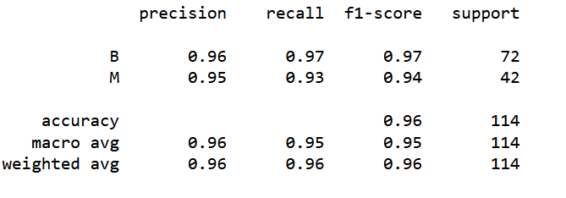
Confusion Matrix and Classification Report - SVM
 | Predicted B | Predicted M
Actual B | 70 | 2
Actual M | 3 | 39

Slide 7
Key Insights - SVM
Precision: Out of all the times the model has predicted the outcome as true, how many of it was actually true or what percentage of the predicted outcome was true. 96% of the time our model has predicted correctly.
Recall: It is the ratio of true positive to the sum of true positive and false negative. It helps identify the percentage of true values that were identified correctly. Our model has a recall value of 96%.
F1-Score: It is the overall performance of the model. It is obtained by taking precision and recall and obtaining their weighted average. Our f1-score is 0.96, which means we have a good model in our hands.

Slide 8
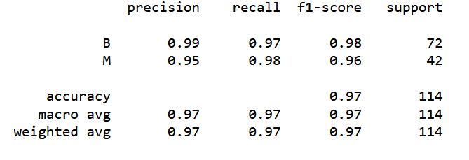
Confusion Matrix and Classification Report – Logistic Regression
 | Predicted B | Predicted M
Actual B | 70 | 2
Actual M | 1 | 41

Slide 9
Key Insights – Logistic Regression
Precision: Out of all the times the model has predicted the outcome as true, how many of it was actually true or what percentage of the predicted outcome was true. 97% of the time our model has predicted correctly.
Recall: It is the ratio of true positive to the sum of true positive and false negative. It helps identify the percentage of true values that were identified correctly. Our model has a recall value of 97%.
F1-Score: It is the overall performance of the model. It is obtained by taking precision and recall and obtaining their weighted average. Our f1-score is 0.97, which means we have a good model in our hands.

Slide 10
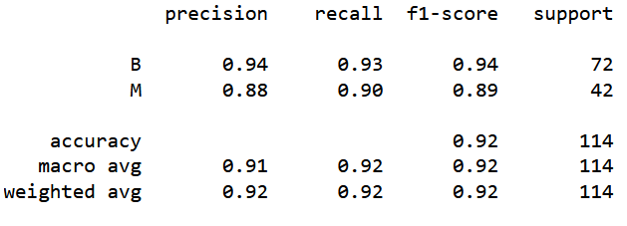
Confusion Matrix and Classification Report – Decision Tree
 | Predicted B | Predicted M
Actual B | 67 | 5
Actual M | 4 | 38

Slide 11
Key Insights – Decision Tree
Precision: Out of all the times the model has predicted the outcome as true, how many of it was actually true or what percentage of the predicted outcome was true. 92% of the time our model has predicted correctly.
Recall: It is the ratio of true positive to the sum of true positive and false negative. It helps identify the percentage of true values that were identified correctly. Our model has a recall value of 92%.
F1-Score: It is the overall performance of the model. It is obtained by taking precision and recall and obtaining their weighted average. Our f1-score is 0.92.

Slide 12
Recommendations
Of all the models we have, in my opinion SVM performs the best.
Out of 42 malignant cases, the SVM model has predicted 39 correctly and 3 wrongly.
Also, SVM has predicted 70 out of 72 cases correctly. It has an f1 score of 0.96
The Decision Tree Model and the Logistic Regression Model has an f1 score of 0.92 and 0.97 respectively.
When we look at the models, Decision Trees perform the worst and Logistic Regression performs the best.
But we have a lot of variables and not much data. We have 31 variables and 570 data.
This shows that the Logistic regression may be overfitting(Bassey, 2019) .
Among the three models we have the model that is not vulnerable to overfitting is SVM (Liberman, 2020).
So, it is better to consider the results of the Support Vector Machine.

Slide 13
Improvements
The number of data here is insufficient as we have a lot of independent variables. So, collecting more data would definitely improve the performance of model and prevent it from overfitting.
Unwanted independent variables should be removed and only the important variables should be put in the dataset.

Slide 14
Reference
Bassey, P. (2019, September 19). Logistic regression vs support vector machines (SVM). Medium. Retrieved August 10, 2022, from https://medium.com/axum-labs/logistic-regression-vs-support-vector-machines-svm-c335610a3d16
Liberman, N. (2020, May 21). Decision trees and random forests. Medium. Retrieved August 10, 2022, from https://towardsdatascience.com/decision-trees-and-random-forests-df0c3123f991

Slide 15
Thank You

